Slide 1
Abstract algebra ch 2 groups

Slide 2
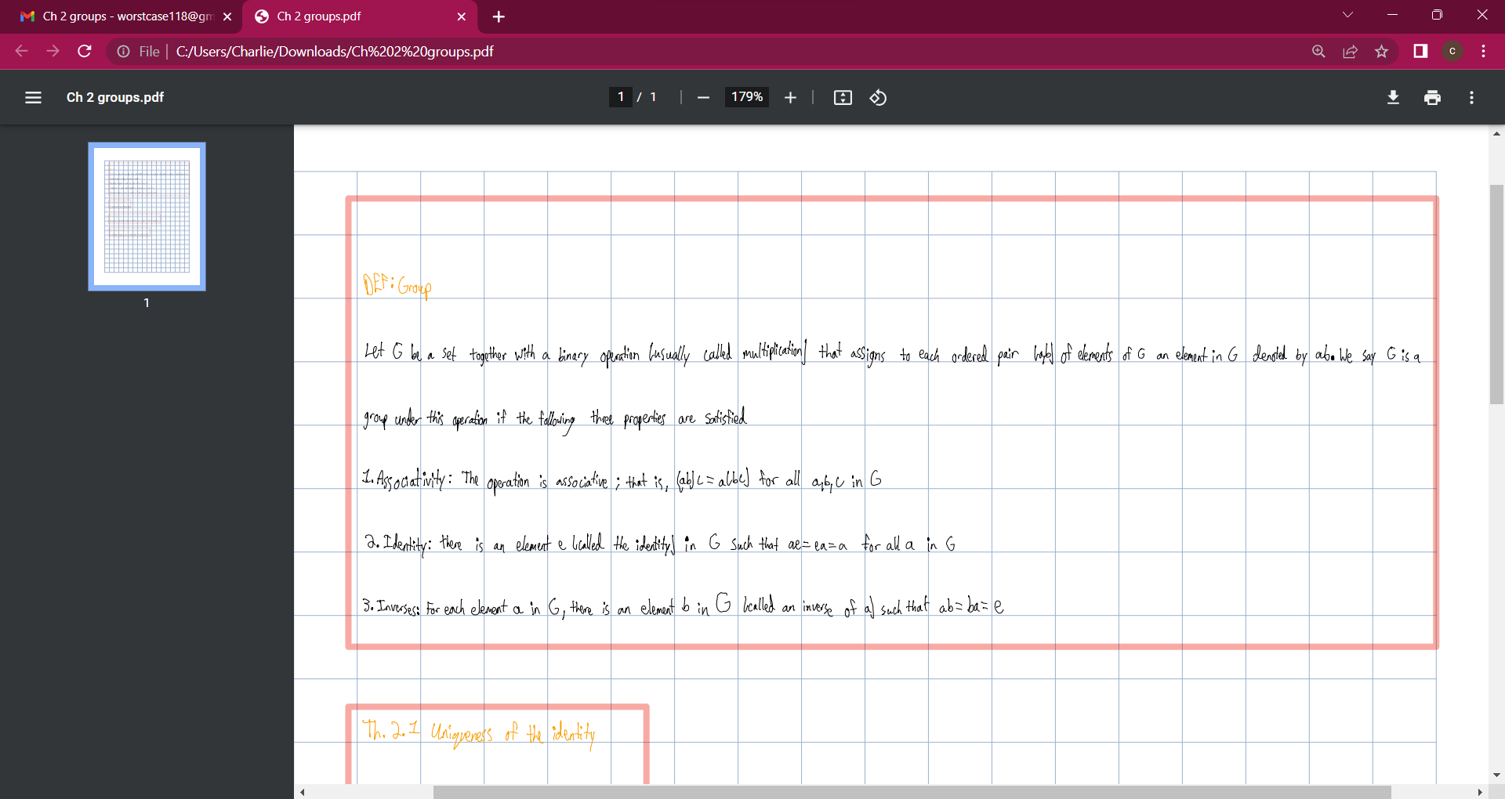

Slide 3
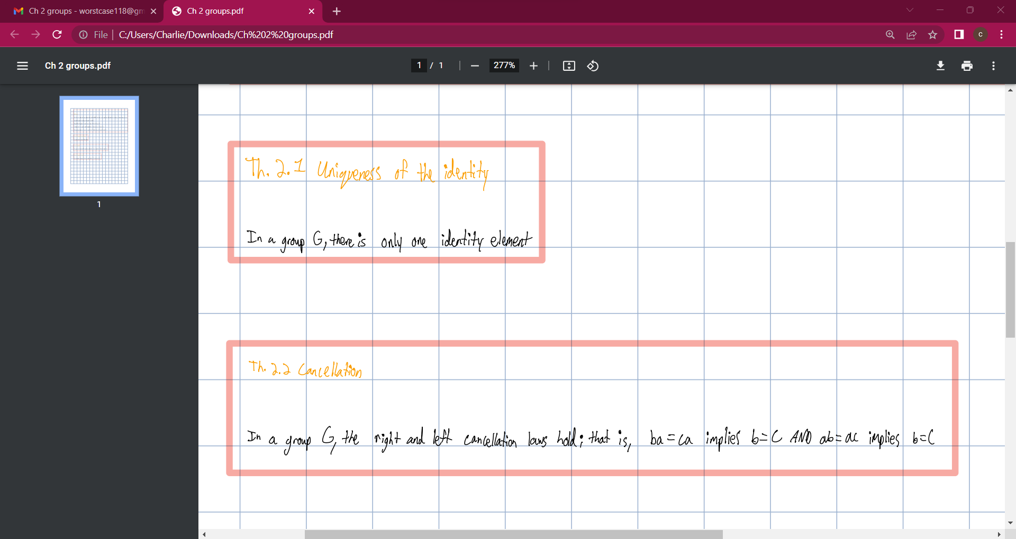

Slide 4
